Slide 1
Traffic Signal Detection Using Computer Vision
Project Progress Presentation

Slide 2

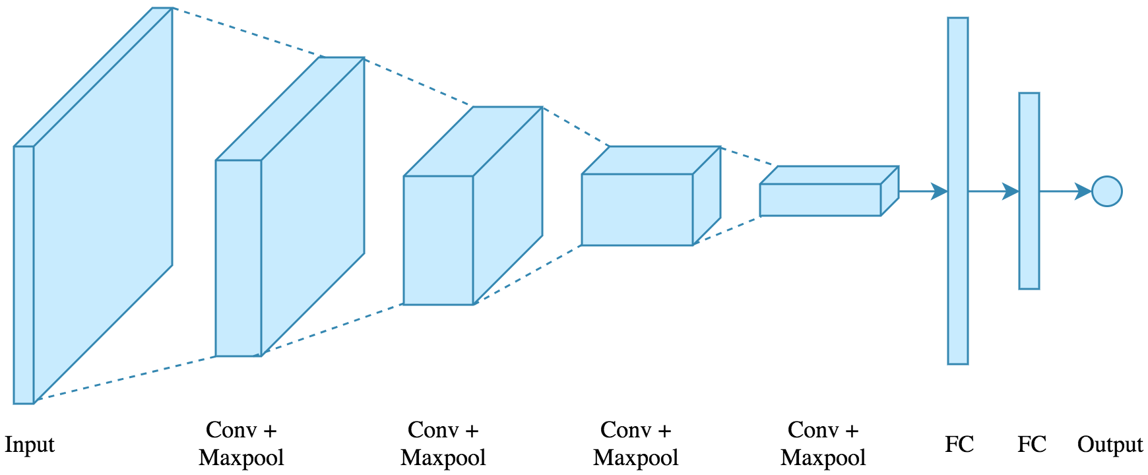
What have we done till now?
Learned about tensorflow and keras libraries(still in progress).
Built and trained images on a basic 4 sets of conv2D layers.
The model is trained on the images of size 30X30.

Slide 3
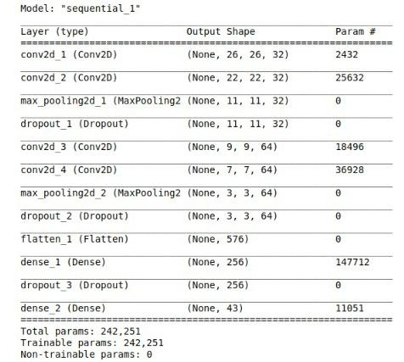
Model’s Summary

Slide 4
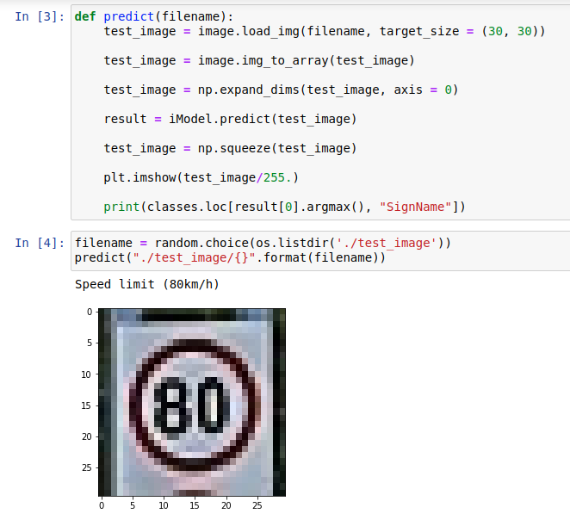
Model’s Prediction

Slide 5
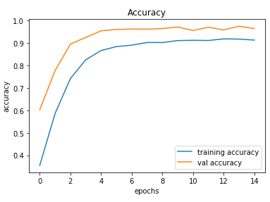
Train Accuracy:
91.24%
Validation Accuracy:
96.35%
Test Accuracy:
92.61%

Slide 6
What are we working on?
The recognition phase.
Researching about image processing and data augmentation.
Building and training different models and testing their accuracy.

Slide 7
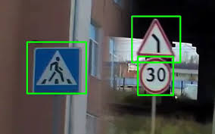
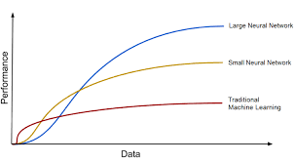

What will we work on?
Improving the current model’s accuracy.
The detection phase.
Integration of text-to-speech.

Slide 8
End Of Report

